Slide 1
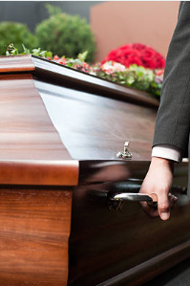
Clinical Practicum
FSAD 129

Slide 2
Objective
Each student in the FSAD program is required to complete a 5-week, 100-hour Clinical Practicum in a funeral home of their choice

Slide 3
Requirements
Student is responsible in securing a Clinical Practicum site for this experience
Funeral homes should have a minimum 100 call volume and must be in good standing with the State of New York (or other jurisdiction)
Preceptor must be licensed in the State of New York (or jurisdiction) with no violations with the Bureau
This can be a paid or unpaid position

Slide 4
Funeral Home Assessment
Prior to beginning the Clinical Practicum experience, a funeral home must be assessed by either the Program Director or a faculty representative
A funeral home assessment report must be completed (faculty responsibility)
An affiliation agreement must be in place

Slide 5
Funeral Home Assessment
An air quality control report is required
  An air quality control monitor must be used during each embalming with a student present
The funeral home must be a safe working environment conducive to the learning experience

Slide 6
Preceptor
Preceptor is responsible for signing and dating all documents related to this Clinical Practicum experience
Preceptor is responsible for doing a student evaluation at the end of the Clinical Practicum experience
Preceptor retains the right to cancel this experience upon notification of the Program Director

Slide 7
Preceptor
If the experience is cancelled, the student is required to terminate their experience immediately upon notification from the Program Director
Preceptor is responsible for contacting the Program Director regarding any behavioral or professional concerns they may have concerning the student
Program Director Contact Information:
1-315-386-7170 (office) 1-585-356-4929 (cell)

Slide 8
Student Responsibility
Complete 100 work hours in the funeral home setting
Complete 5 embalming reports (revised January 1, 2025)
Complete 5 funerals / case reports
Learn how to properly document and create funeral related forms
Observe and create (under direct supervision of the preceptor) a DAVE application
Sit in on arrangements
Actively participate in the embalming process

Slide 9
Embalming
Effective January 1, 2025, the embalming report has changed
This new report is required for all embalming cases
5 embalmings are required without exception

Slide 10
Embalming
Cremation cases can be embalmed if the funeral director asks the family for permission to embalm their loved one without charge for this Clinical Practicum experience
  Note: some funeral directors feel uncomfortable asking families for this request
A funeral home that has a large amount of cremations with minimal embalming is no excuse – 5 embalmings are required
What changed on the embalming report?

Slide 11
Air Quality Control Reporting
Effective January 1, 2025, all funeral homes are to have an air quality control report on file with the FSAD department
A formaldehyde monitor is required to be present in the room during all embalmings with a student
Either the student or the funeral home may purchase this monitor

Slide 12
Air Quality Control Reporting
At the end of each embalming, the formaldehyde exposure must be documented on the embalming report, and a photograph of the monitor reading must be added to the embalming report
To ensure compliance with student safety and the OSHA standards, formaldehyde monitoring is a program requirement for every embalming, every time, on campus and at Practicum & Internship sites.

Slide 13
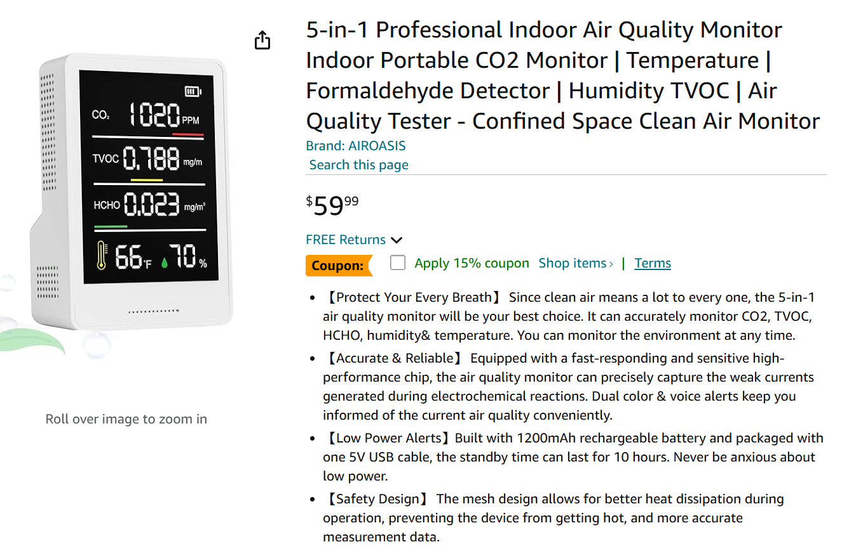
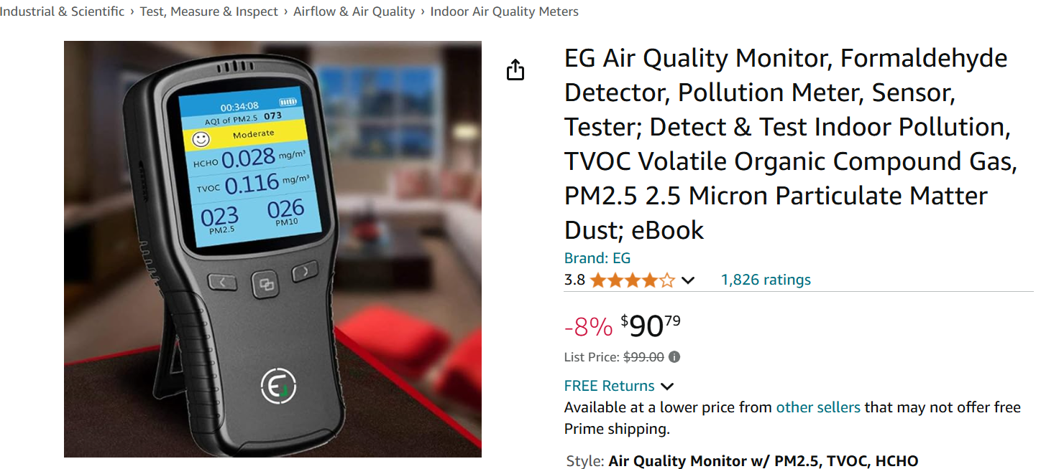
Air Quality Control Reporting
No embalming reports will be accepted without a formaldehyde exposure reading and photograph attached

Slide 14
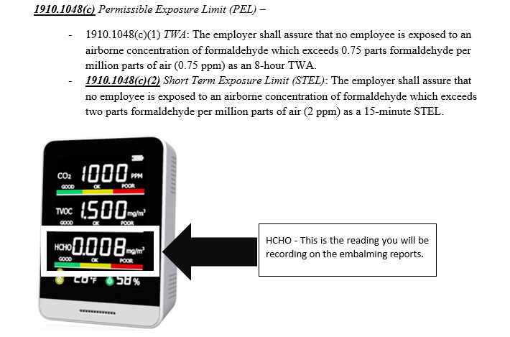

Slide 15
Numbering and Saving Embalming Reports
Scan 3 or 4 Embalming Reports together
Save documents correctly
  Example: Penepent_D_FSAD 129_EMB_01
The case number on the actual case report will be:
  FSAD 129_EMB_01

Slide 16
Case Reports
Upon completion of the Clinical Practicum experience, the student will have completed each of the tasks at least once on these forms
Can I use 2 or 3 cases together to accomplish the minimum requirements?

Slide 17
Case Reports
Scan all Case Reports together
Save documents correctly
  Example: Penepent_D_FSAD 129_Case_01
The case number on the actual case report will be:
  FSAD 129_Case_01
Concurrent numbering required

Slide 18
Timesheets
Timesheets are to be completed at the end of every shift
Preceptor and student are responsible for signing each timesheet prior to submission
Again, a minimum of 100 work hours are required for successful completion of this experience
Scan all timesheets together
Save documents correctly
  Example: Penepent_D_FSAD 129_Timesheets

Slide 19
Student Essay
Student is required upon completion of their Clinical Practicum experience to write a 1 page essay on what they learned
  What skill(s) they learned
  How they liked their Clinical Practicum experience
  Would they like to work for this funeral home and why or why not
  Save document correctly
    Example: Penepent_D_FSAD 129_Essay

Slide 20
Journal
Student is required upon the end of every shift to journalize what they did during their time at the Clinical Practicum experience
There are two sample journals and either form is acceptable
Save document correct
  Example: Penepent_D_FSAD 129_Journals

Slide 21
Student Evaluation
Student is required to complete a student evaluation of their preceptor and their experience
First part of this evaluation must be in alignment with the preceptor’s evaluation
Save document correctly
  Example: Penepent_D_FSAD 129_Preceptor Eval

Slide 22
Forms
All forms for the Clinical Practicum experience are posted on the FSAD website
https://www.canton.edu/sci_health/fsad/forms/
In the event there is a problem or concern with the Clinical Practicum experience, it is the student’s responsibility for contacting the Program Director immediately

Slide 23
Uploading Forms
All forms must be uploaded to OneDrive
To access OneDrive: Login at https://onedrive.live.com/about/en-us/signin OR log into your email account, click on the 9-dot square in the upper lefthand corner and click on OneDrive
Create a folder labeled LASTNAME_COURSE, for example: Penepent_FSAD 129_Practicum Clinical
Inside this folder, create the following sub folders: Embalming Reports, Case Reports, Assignments (1-Page Report), Timesheets, Journal, Preceptor Evaluation, and Student Evaluation

Slide 24
Uploading Forms
Upload the corresponding documents into each of these subfolders
Embalming reports can be scanned in batches of 3 or 4 reports, while case reports should be scanned together into one document
When the folder is complete, submit and send the link to the folder
  Click on Share, then copy the link that pops up

Slide 25
Submission Dates
Schedule for Submission
Spring Term: all documents must be submitted by May 1st
  In the event there is missing work, student may request an incomplete to finish the work over the summer
  Incomplete forms are due May 1st
  All missing assignments for the Clinical Practicum experience must be submitted by August 1st
  Failure to submit all work prior to August 1st will result in a failing grade and student will be required to retake the Clinical Practicum experience over

Slide 26
Submission Dates
Fall Term: all documents must be submitted by December 1st
  In the event there is missing work, student may request an incomplete to finish the work over the Winter break
  Incomplete forms are due December 1st
  All missing assignments for the Clinical Practicum experience must be submitted by February 1st
  Failure to submit all work prior to August 1st will result in a failing grade and student will be required to retake the Clinical Practicum experience over

Slide 27
Thank You
https://www.canton.edu/sci_health/fsad/

Slide 28
Conclusion of Presentation

